Slide 1
Source Estimation in Visual Experiments
David Kim
UCB/UCSF Bioengineering

Slide 2
I. Background
II. Method
III. Results

Slide 3
Background
II. Methods
III. Results

Slide 4
Research Interest
Analyze visual experiments with non-invasive neuro-imaging for human subjects
Accurate characterization of temporal response for each visual area

Slide 5
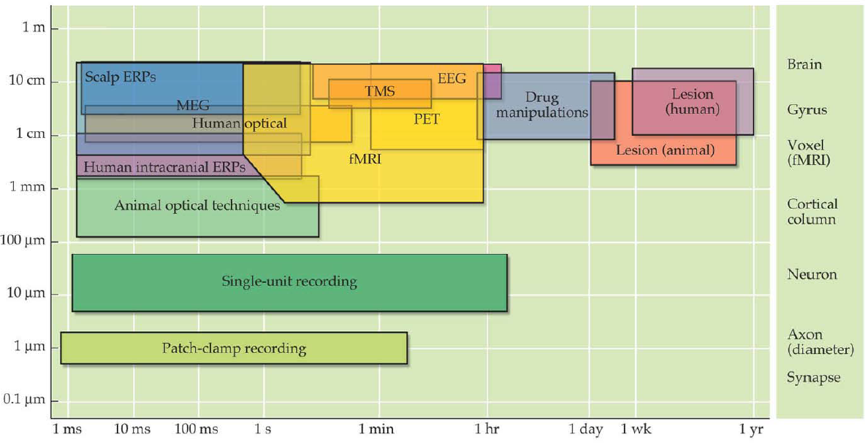
Neuro-Imaging Techniques
Non-invasive techniques
High temporal resolutions : EEG/MEG
High spatial resolutions : MRI/fMRI

Slide 6
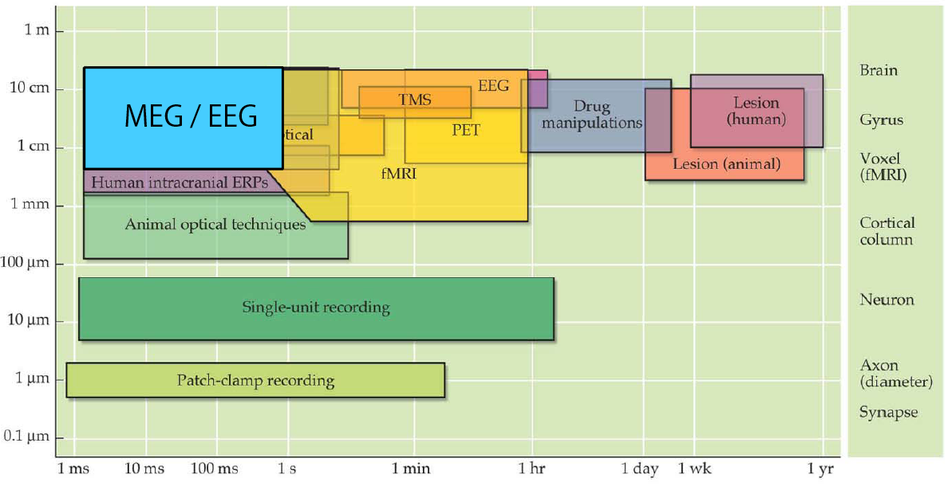
Neuro-Imaging Techniques
Non-invasive techniques
High temporal resolutions : EEG/MEG (msec)
High spatial resolutions : MRI/fMRI

Slide 7
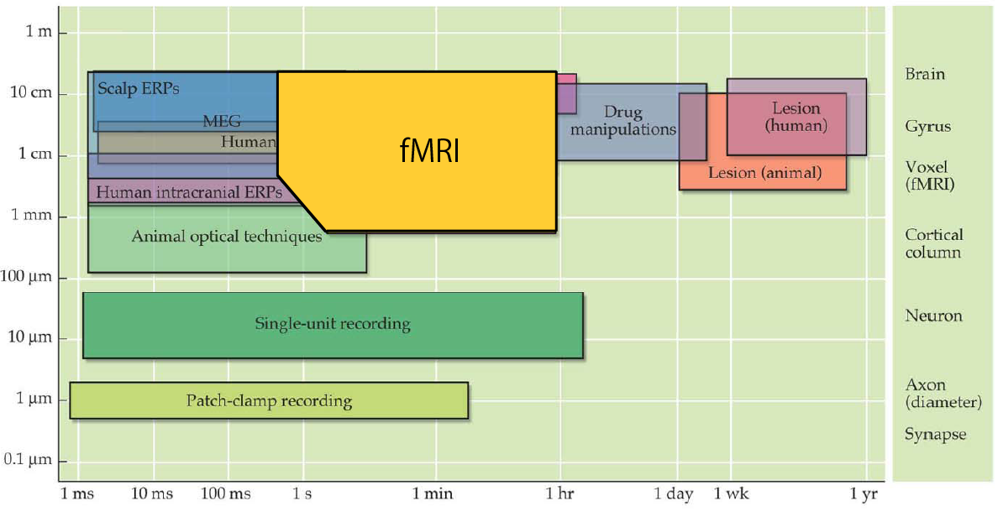
Neuro-Imaging Techniques
Non-invasive techniques
High temporal resolutions : EEG/MEG
High spatial resolutions : MRI/fMRI (mm)

Slide 8
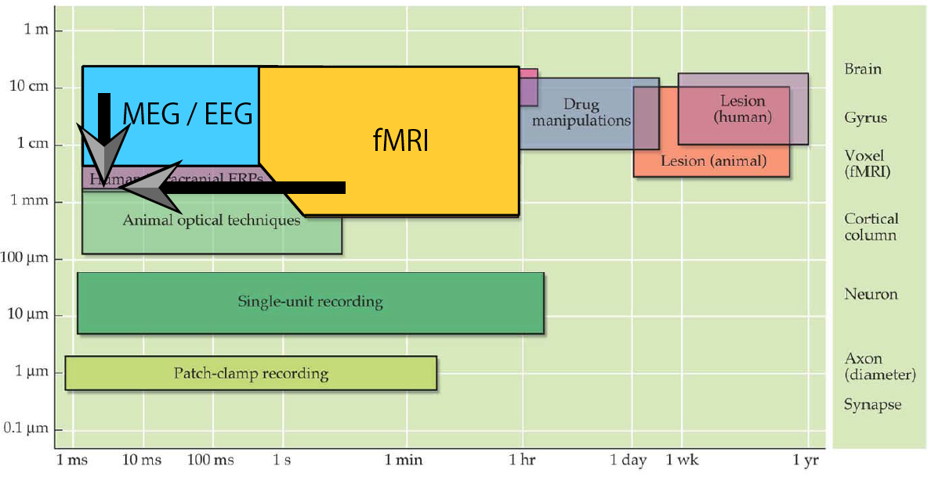
Neuro-Imaging Techniques
Non-invasive techniques
High temporal resolutions : EEG/MEG
High spatial resolutions : MRI/fMRI

Slide 9

Visual Information of Interest
Basic Visual information include:
Contrast / Luminance
Orientation

Slide 10
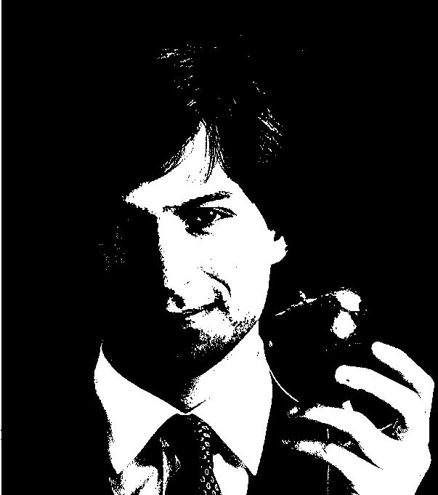
Visual Information of Interest
Early Visual information include:
Contrast / Luminance
Orientation

Slide 11
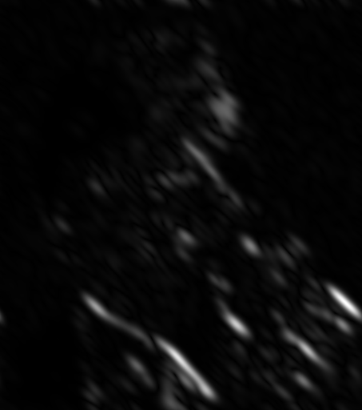
Visual Information of Interest
Early Visual information include:
Contrast / Luminance
Orientation

Slide 12
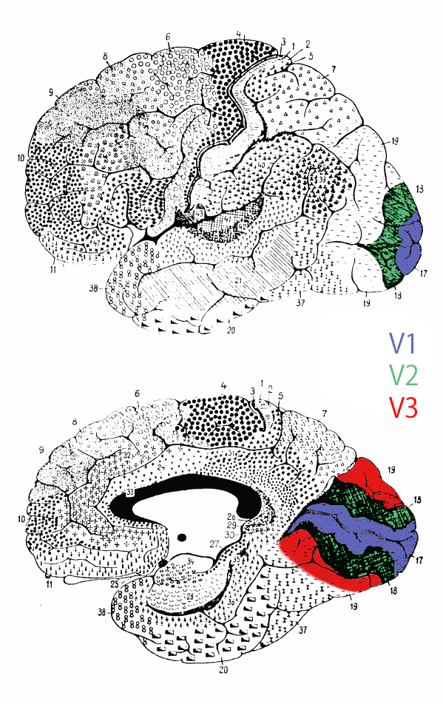
Early Visual Areas on Cortex
Occipital Cortex
Major Processing Areas
V1
V2
V3

Slide 13
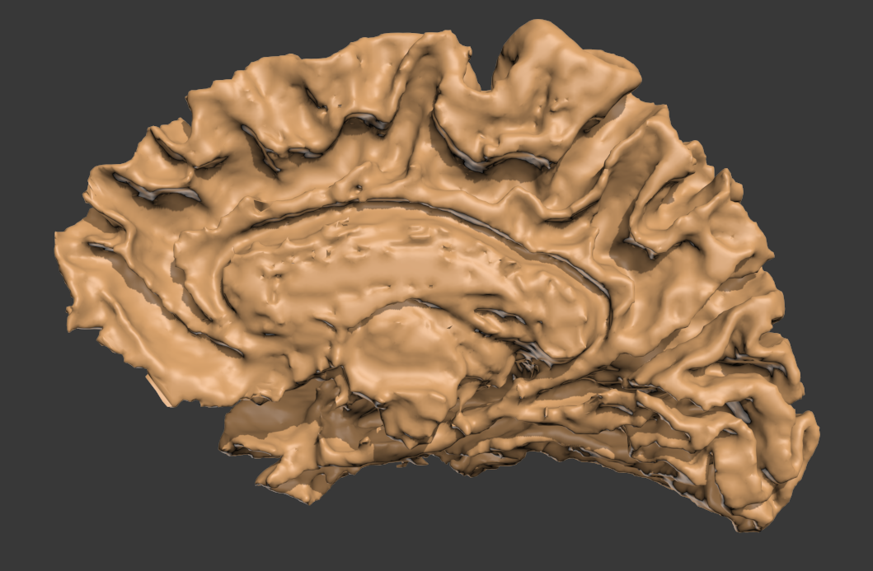
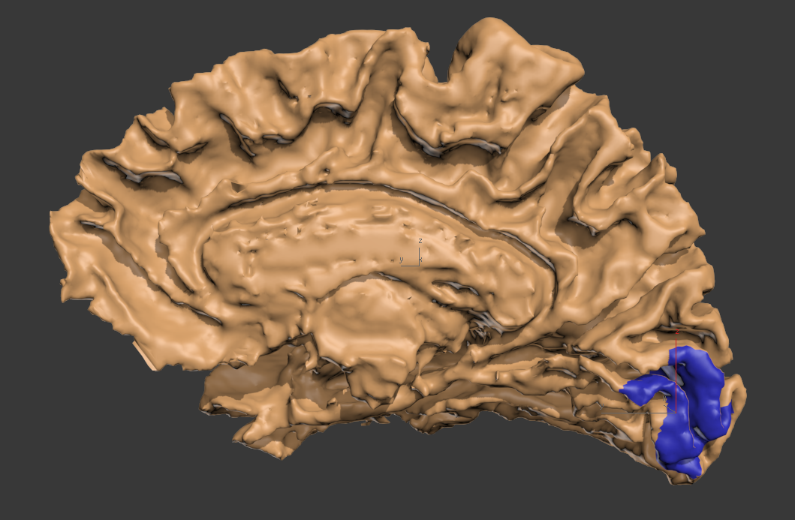
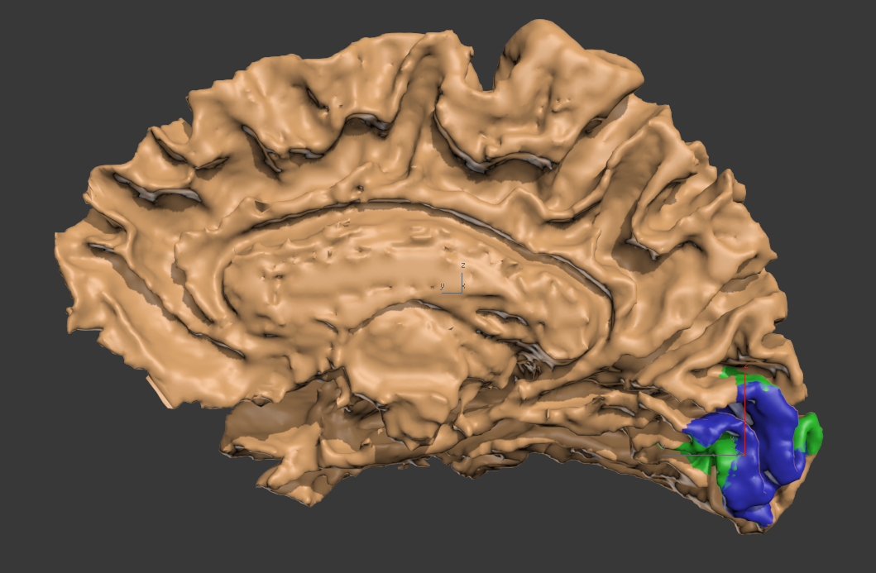

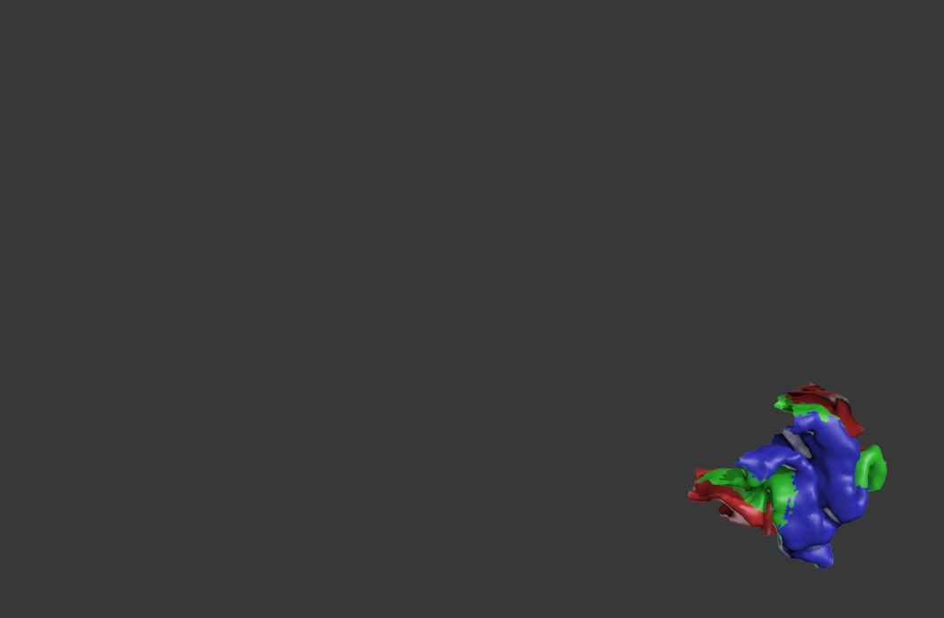
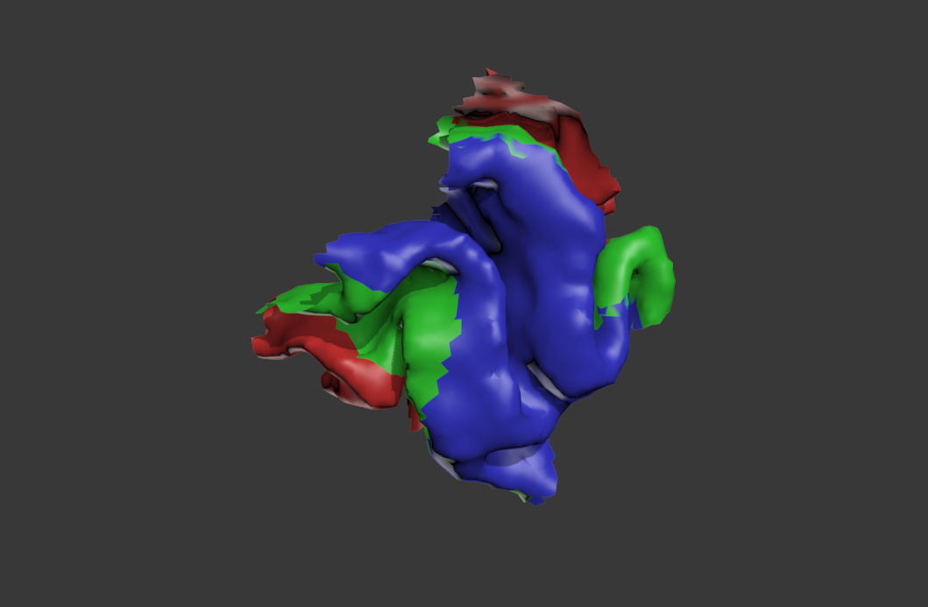
Early Visual Areas on Cortex
convoluted
compact

Slide 14
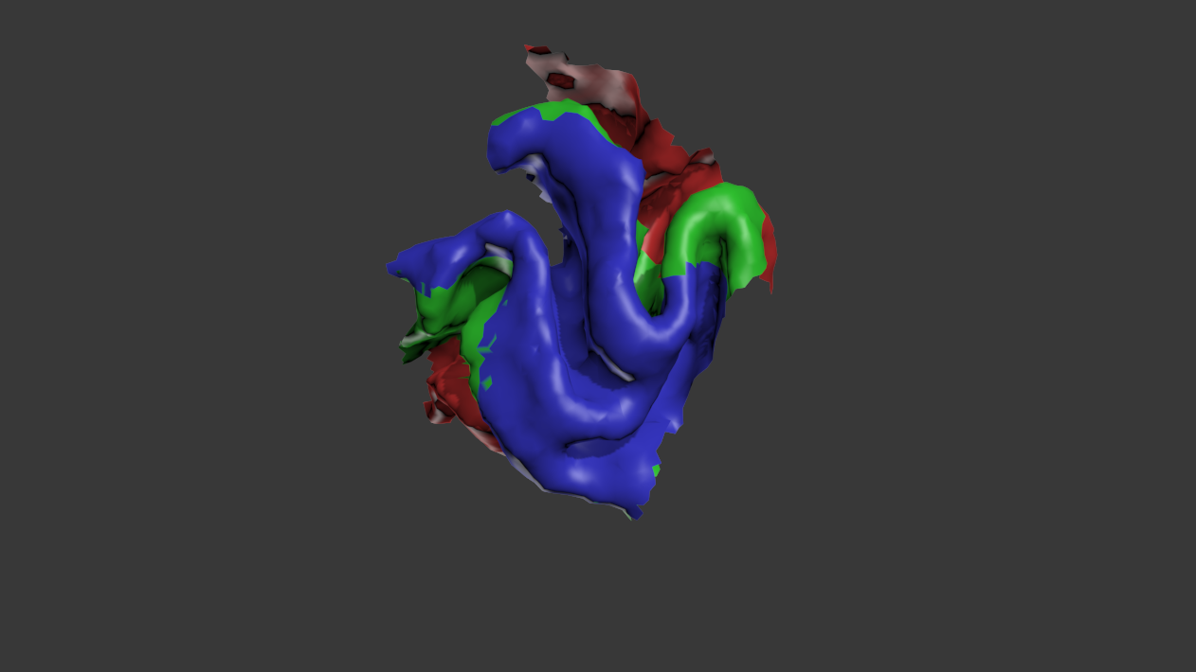
Early Visual Areas on Cortex
convoluted
compact

Slide 15
Early Visual Areas on Cortex
}
convoluted
compact
Source estimation becomes difficult

Slide 16
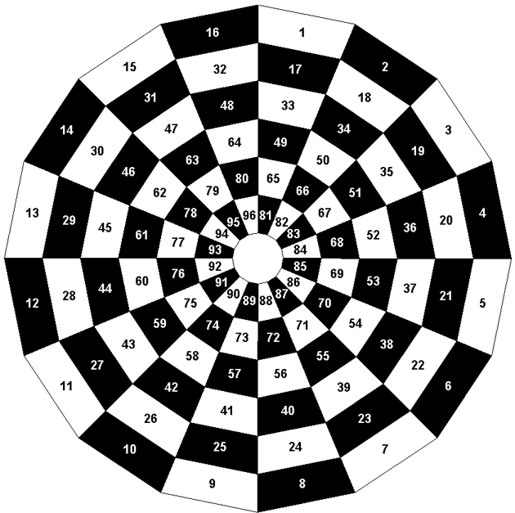
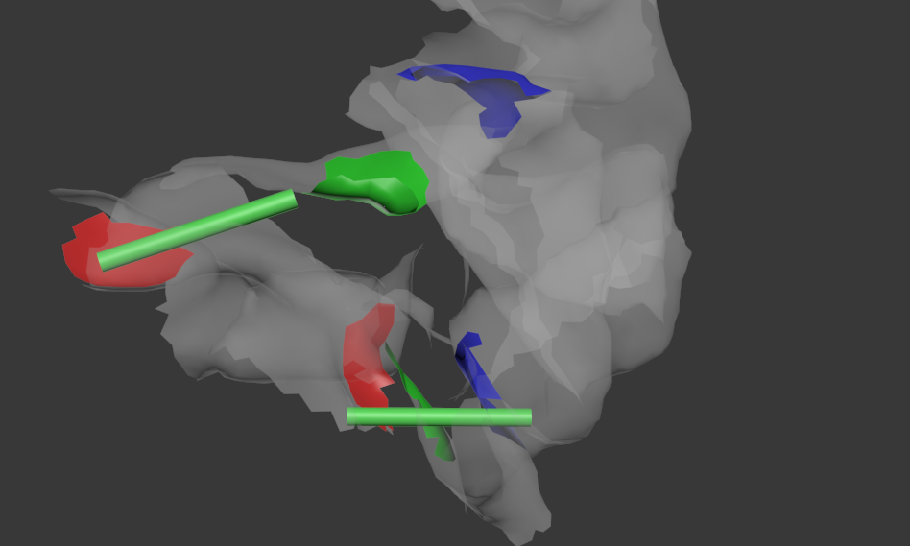
Challenges in visual expt: Resolving proximal sources
Visual Field in 96 partitions
Patch #15
1 cm
Patch #93

Slide 17
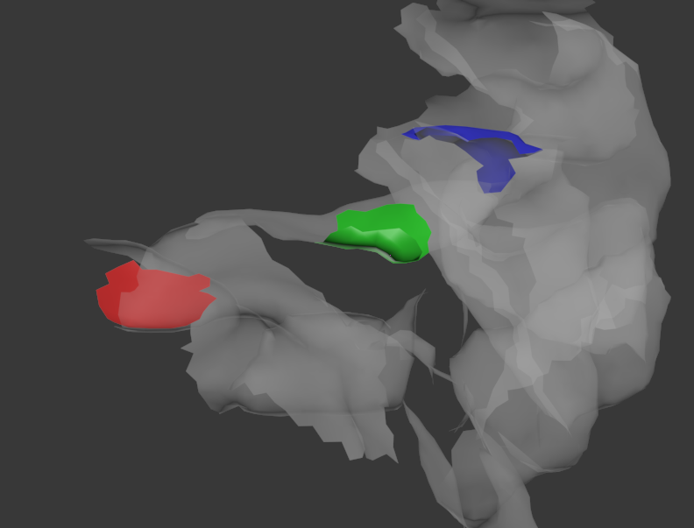
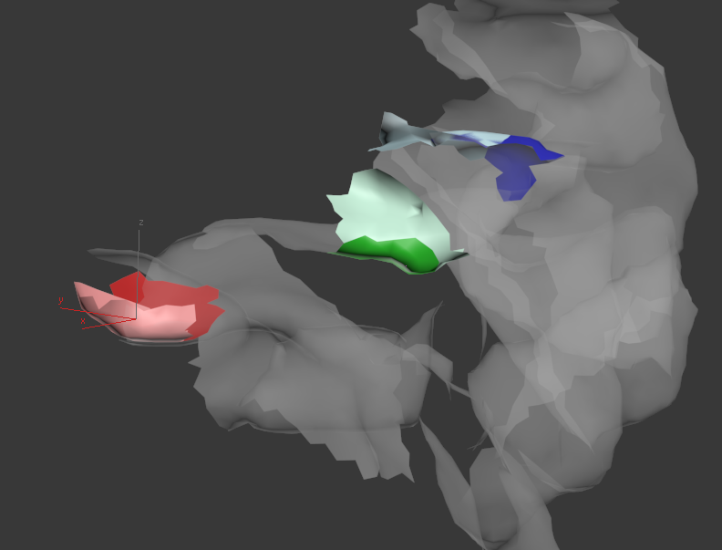
Challenges in visual expt: Resolving convoluted sources
Because the occipital surfaces are highly folded, even small error in parameterization has large consequences at patch level.
4 mm shift
1 cm
#15 @ original position
#15 @ shifted position

Slide 18
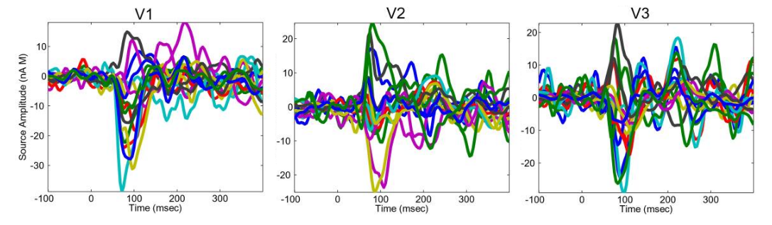
Challenges in visual expt:
Trying to estimate source time functions from single patch experiment often results in highly variable time course.
1 cm
Hagler et al. (2009)

Slide 19
I. Background
Methods
III. Results

Slide 20
Conceptual Approach
Any single patch has some error associated as a result of noisy and misinformed model parameters
However, a larger ensemble dataset can effectively average out some of these errors when provided with additional appropriate constraints.

Slide 21
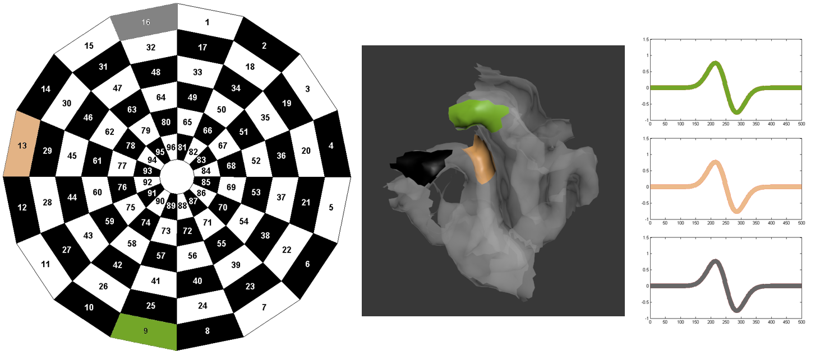
Previous Works (Providing Additional Constraint)
1. Common Response Assumption (CRA)
When presented with identical stimuli, then cortical sources at similar eccentricities will respond identically

Slide 22
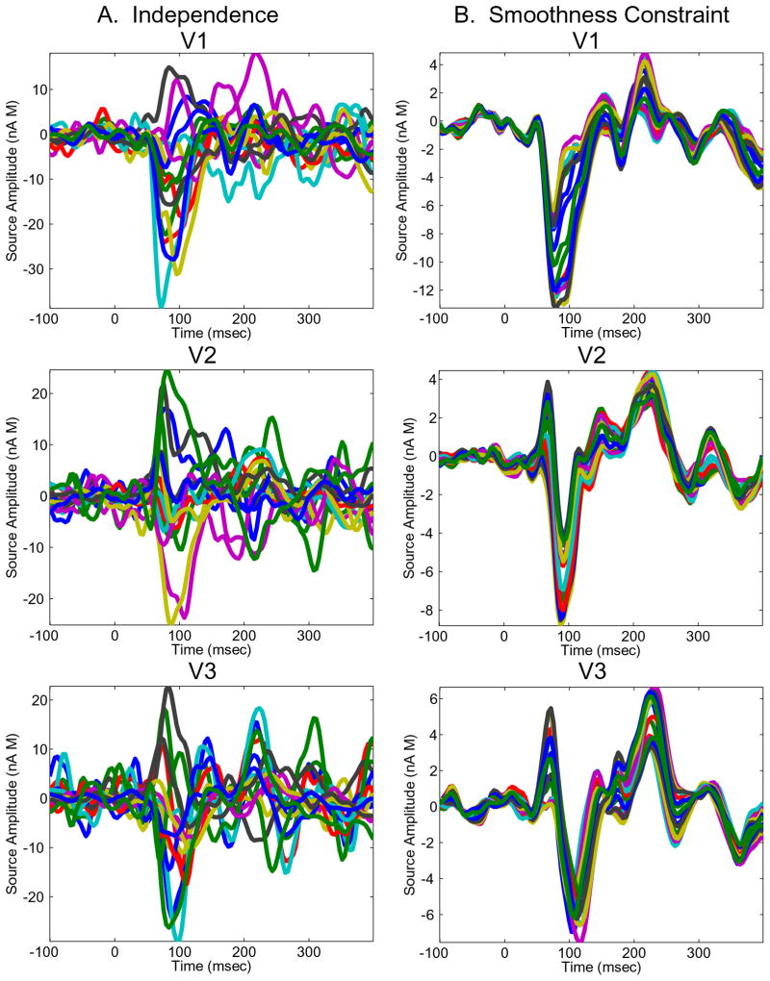
Previous Works
Application of CRA

Slide 23
Previous Works
2. Common Topography Assumption (CTA)
The cortical boundaries of activations are determined only by the boundaries of the stimulus. i.e stimulus contents have insignificant effects in determining cortical boundaries

Slide 24
Source Estimation
Typically, one generates a inversion operator W, that operates on the data such that the resulting estimation of time response minimizes some error estimate

Slide 25
Source Estimation
In typical single patch visual experiment, W is generated from forward model and relies heavily on the geometrical properties of the subject
In our methods, we perform preliminary calibration experiments and use the resulting empirical ensemble data, to enhance W (resulting in an improved ensemble inverse operator, WE)

Slide 26
Methods
f/MRI per patch
Sensor Config.
1 patch localization
Typical Inverse
Generator
Empirical Inverse
Generator
f/MRI per patch
Sensor Config.
Multi-patch localization

Slide 27

Source Estimation

Slide 28
I. Background
II. Methods
Results

Slide 29
Simulation & Results
Simulation Scenarios
Ideal Conditions
#, location, orientation of sources are accurate
2. Error in geometry by MRI and segmentation
Errors cortical orientations
3. Error in source localization by fMRI
Errors in cortical location

Slide 30

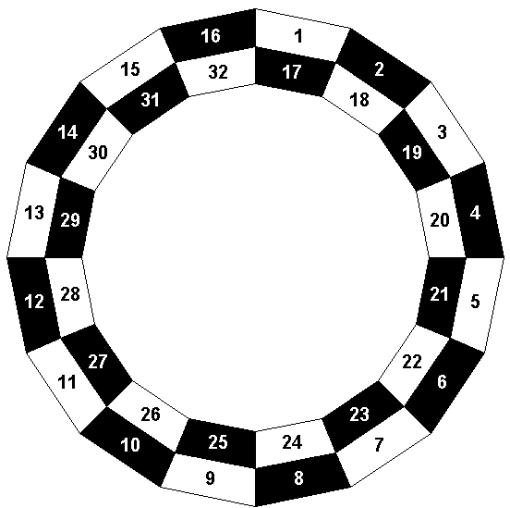
Simulation – Performance Test
Generate correlation measures for the time functions between T&T` for 20 Subjects * 32 Patches on 2 peripheral rings (total of 640 time courses per visual area)
640 T1`
640 T2`
640 T3`

Slide 31
Simulation – Performance Test
Calculate correlations for each estimates per patch.
640 T1`
640 T2`
640 T3`
V1
V2
V3
640 R1
640 R2
640 R3
Estimates , True

Slide 32
Simulation – Performance Test
Histogram of 640 correlations.
(Blue=T1, green=T2, Red=T3)
Histogram skewed toward 1 (right) means better performance.
In this example data, WE has not performed better than W.

Slide 33
Scenario 1: Ideal Conditions
For each patch, all relevant source characteristics are known and are accurate. All assumption holds.
Test | W | WE
1. Ideal | + | +
2. Normal
2. Location
2. External

Slide 34
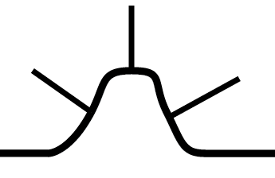
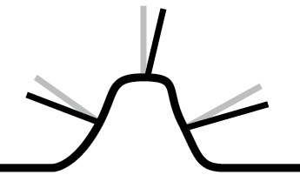
Scenario 2: Error in Segmentation
What should have been used
for source analysis
(i.e. true directions of pyramidal cell organization that generates signal)
What was actually used for source analysis

Slide 35
Scenario 2: Error in Segmentation
Test | W | WE
1. Ideal | + | ?
2. Normal | - | +
2. Location
2. External

Slide 36
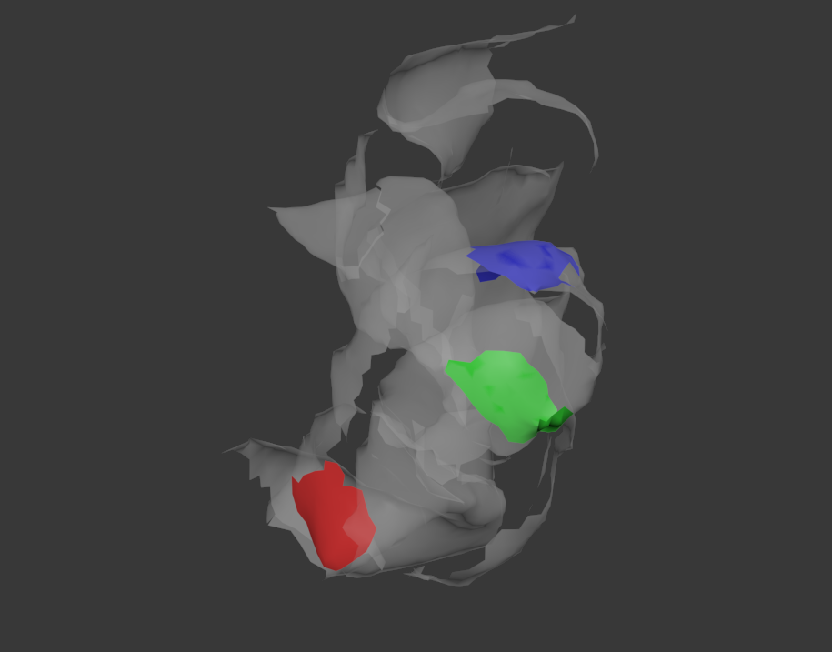
Scenario 3: Error in Localization
Due to some error in fMRI/MRI coregistration or misinterpretation of fMRI data, there are discrepancies between true source locations and assumed source locations
True Source Locations

Slide 37
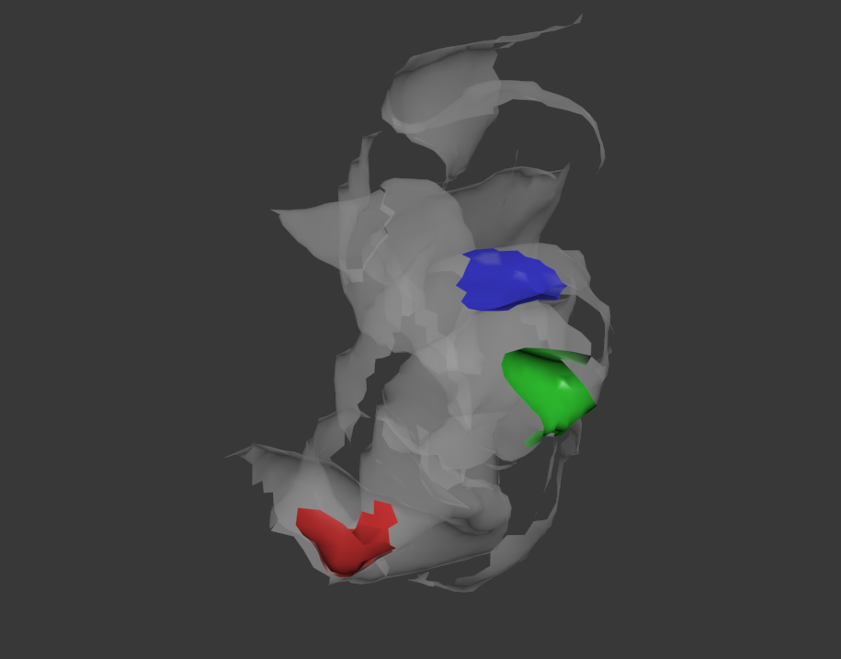
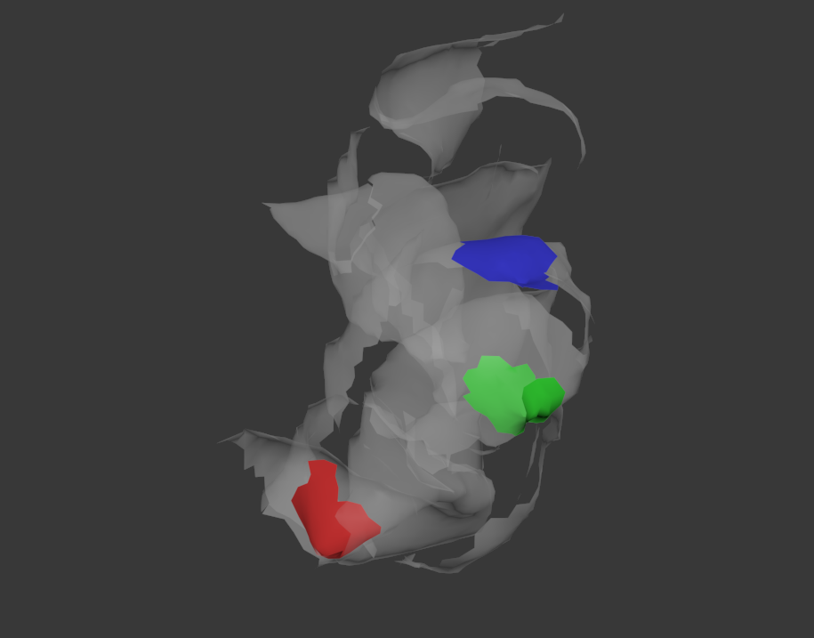
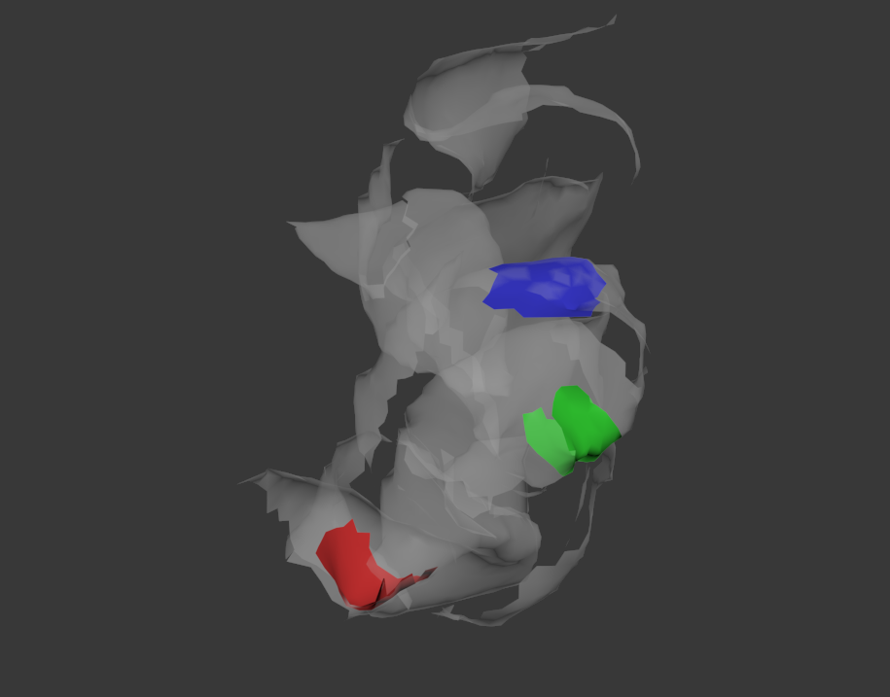

Scenario 3: Error in Localization
Due to some error in fMRI/MRI coregistration or misinterpretation of fMRI data, there are discrepancies between true source locations and assumed source locations
Assumed Source Locations

Slide 38
Scenario 3: Error in Localization
Test | W | WE
3. Location |  | +

Slide 39
Strengths and Weaknesses
Advantages
Gives inversion operator that can be used in human visual experiments which are typically challenging
Very effective at eliminating wide variety of random errors
Disadvantages
There are many preliminary experiments that must be performed:
Calibration multifocal VEP experiment
Multifocal f/MRI retinotopy
Common Topography Assumption must be validated before WE can be used for single patch experiments that involve various stimuli

Slide 40
Appendix

Slide 41
Plausible Validation Experiment for CTA
Many Patches
Empirical Inverse
Generator
f/MRI per patch
Sensor Config.
96 patch Multifocal VEP
Empirical Inverse
Generator
f/MRI per patch
Sensor Config.
48/96 patch Multifocal VEP
Empirical Inverse
Generator
f/MRI per patch
Sensor Config.
1/96 single patch VEP
Single
Patch

Slide 42
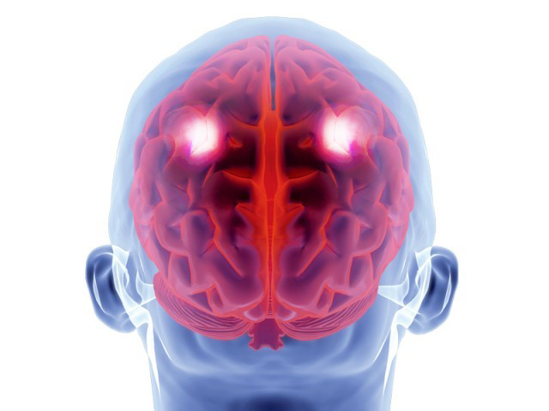
Scenario 4: Unaccounted External Source
2 External Parietal Sources
1.5 cm X 1.5 cm
1. Constant: Constant amplitude, time-locked to stimulus
2. Variable Amplitude across patches: Time-locked
3. Variable Latency across patches: Constant amplitude

Slide 43
Scenario 4: Unaccounted External Source
Test | W | WE
1. Ideal | + | ?
2. Normal | - | +
2. Location | - | +
2. External | - | +?

Slide 44
Scenario 4: Unaccounted External Source
PCA can be used to determine the number of contributing independent sources
If the external sources are distant, spatial filtering methods like beam-forming can be used to isolate the contributions from distant sources
Then run PCA to ascertain that maximum of 3 sources are active

